Slide 1
Domain Research and Exploratory Data Analysis
Lin Zhao | IOT Analytics Team

Slide 2
Agenda
Project Background
Project Objectives
Project Data Management
Descriptions and Locations of related data
Challenges
Initial Descriptive Statistics
Future Recommendations
Conclusion
Notes:
May require more than one slide

Slide 3
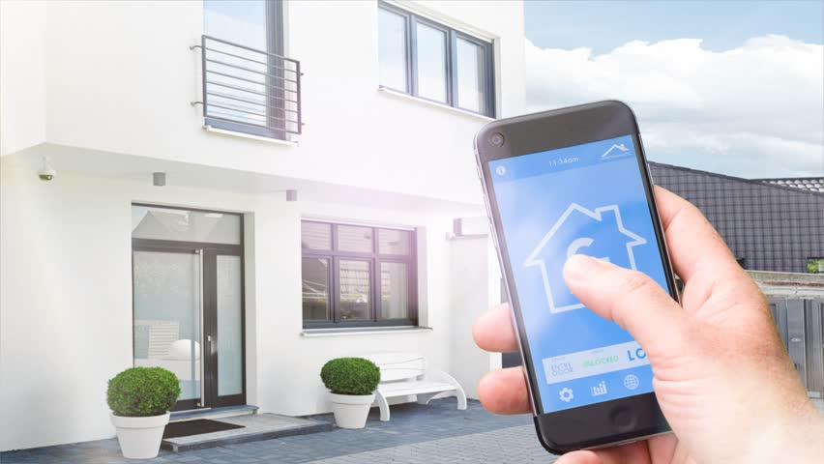
Project Background
Regional home developer is considering to install a new set of electrical sub-metering devices for power management in smart homes.
Installing these sub-meters could be a big step towards the developer's goal of offering energy savings.

Slide 4

Project Objectives
Analyzing the past 47 months of individual household electric power consumption from these sub-metering devices and providing our recommendation to Regional home developer.
Applying analytics and visualizations that would empower Smart Homeowners with greater understanding and control of their power usage.
Our potential client’s goal with these sub-meters is to grow their business in the smart home market

Slide 5

Project Data Management
Store data on the Amazon Web Services (AWS)
Connect to MySQL database to acquire data, authenticated using provided username and password
Select the necessary attributes from the DB without downloading the entire dataset
Easy to combine different years of datasets into one BIG dataset (same attributes)

Slide 6
Descriptions and location of related data
2,075,259 Individual household electric power consumption measurements gathered from Sceaux (7km off Paris, France)
December 2006 to November 2010 (47 months)
Five Attributes: Date, Time, and the 3 sub-meter attributes
Notes:
May require more than one slide

Slide 7
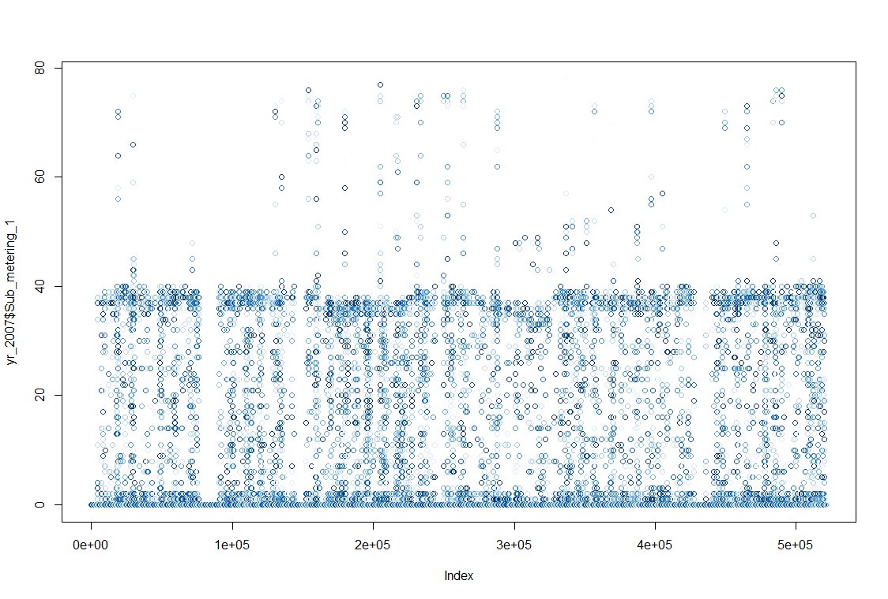
Challenges
Large dataset – Over 2M of observations, one minute apart
Create DateTime Attribute → Data Manipulation
Data needs to be rolled up into larger intervals → Quarter, Month, Week, Day, and Hour
Time Series Analysis → Future Trends Forecast
Notes:
May require more than one slide

Slide 8
Initial Descriptive Statistics
Preliminary analysis on summary of the data – Mean, mode, standard deviation, quartiles & distribution for each year from 2006-2010
Kitchen is using the most power for maximum value
Garage & Yard is using the least power for maximum value
Garage & Yard has the highest average power consumption
Meter Set | Appliances
Sub_metering_1: Kitchen | dishwasher, oven, microwave
Sub_metering_2: Laundry Room | Washing machine, dryer, refrigerator and a light
Sub-metering_3: Garage & Yard | water-heater and an air-conditioner

Slide 9
Future Recommendations 1
Re-categorize devices by their consumption patterns for easier realization of potential savings – See next page for details
Consider to add Sub_metering_4 to separate the water-heater and AC, as both are the top two highly consumed electrical appliances
Consider to add an attribute of “Outdoor Ambiance Temperature”
Consider to add an attribute of “Occupancy of the House”
Consider to set the thermostat of AC for each season in order to keep the room within a comfortable temperature throughout the year to achieve the energy saving goal in the long run
Notes:
May require more than one slide

Slide 10
Future Recommendations 2
Suggested re-organized Sub-metering allocations
Meter Set | Appliances
Sub_metering_1: (Auto Turn-Off) | light, oven, microwave Turn off automatically when nobody is around
Sub_metering_2: (Need-Based) | Washing machine, drier, refrigerator and dishwasher (Can work when nobody is around, but fridge needs to be on all the time)
Sub_metering_3: (High Consumption) *Sub_metering_4: (High Consumption) | water-heater (higher consumption in kwh) air-conditioner (higher consumption in kwh)
Notes:
May require more than one slide

Slide 11

Conclusion
Great Project!
Need to implement these Sub-metering Devices
Need to perform Visualizations and Time Series Analysis
Notes:
May require more than one slide

